Slide 1
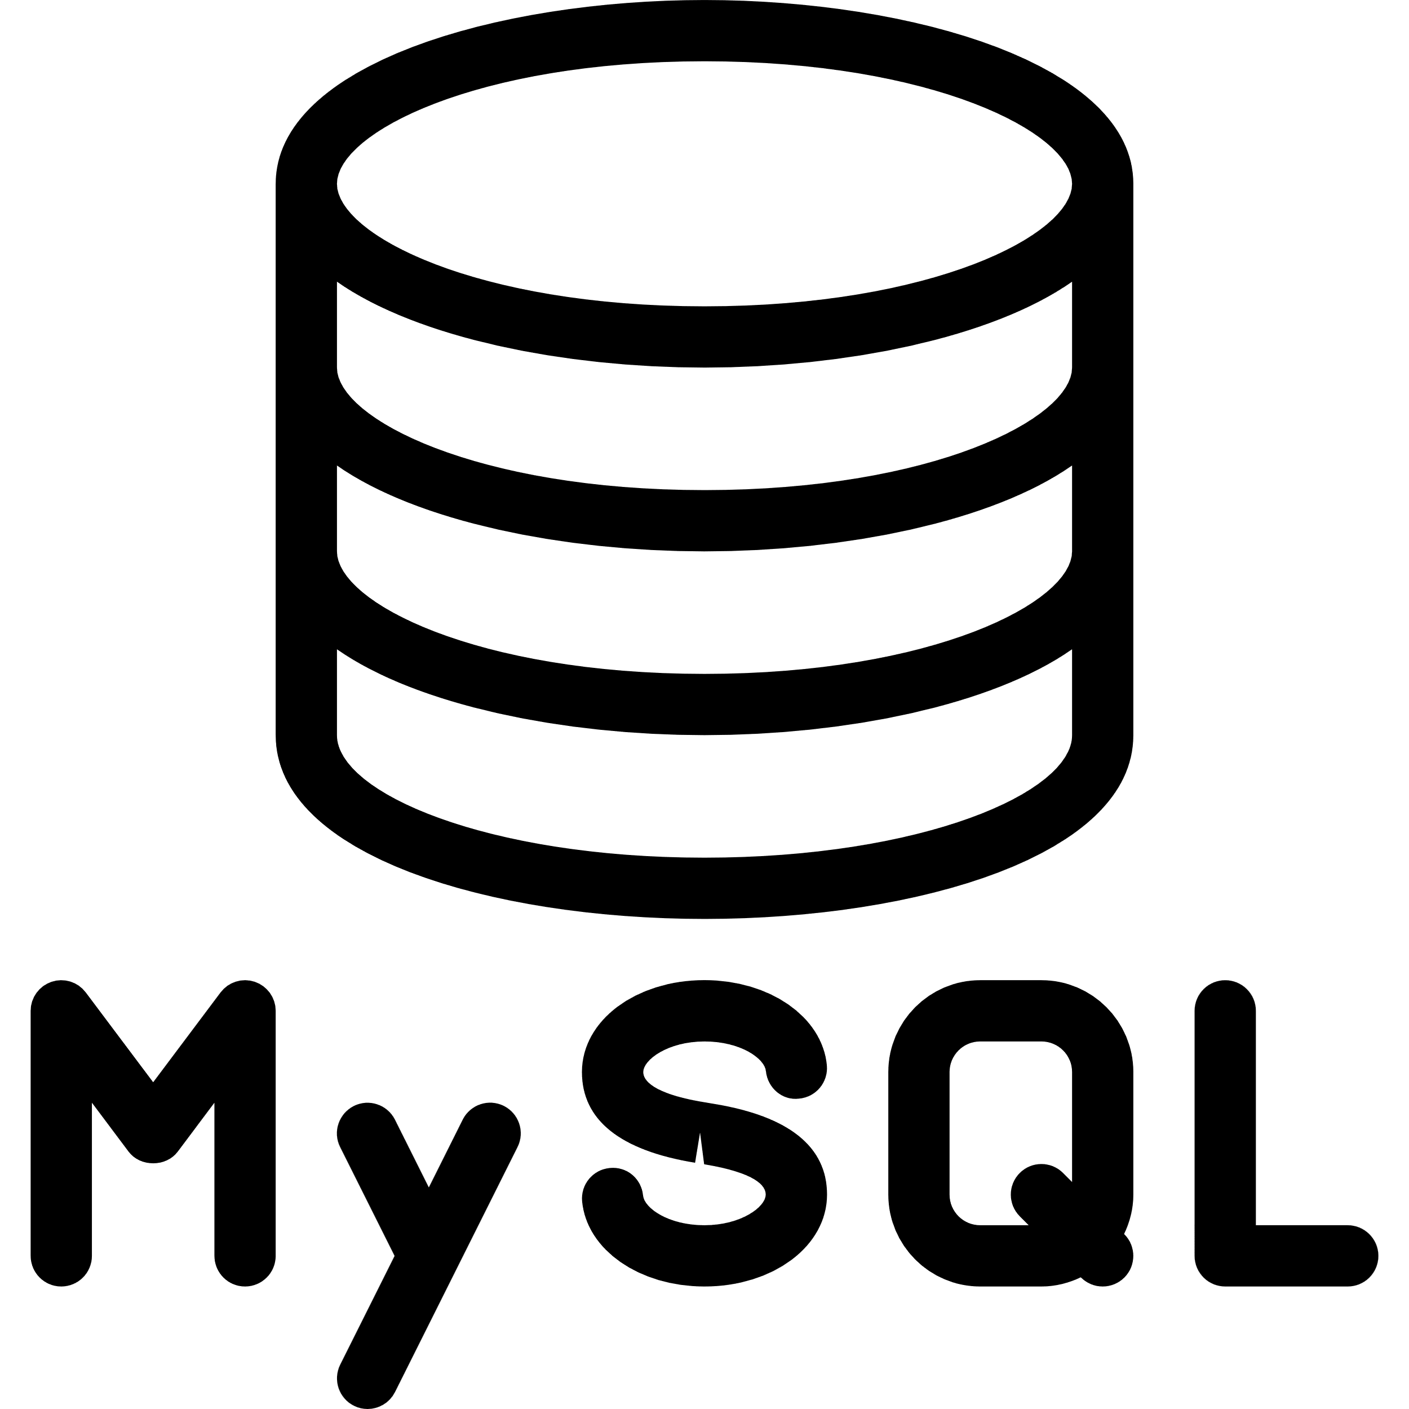
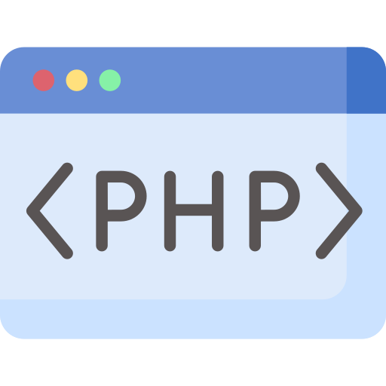

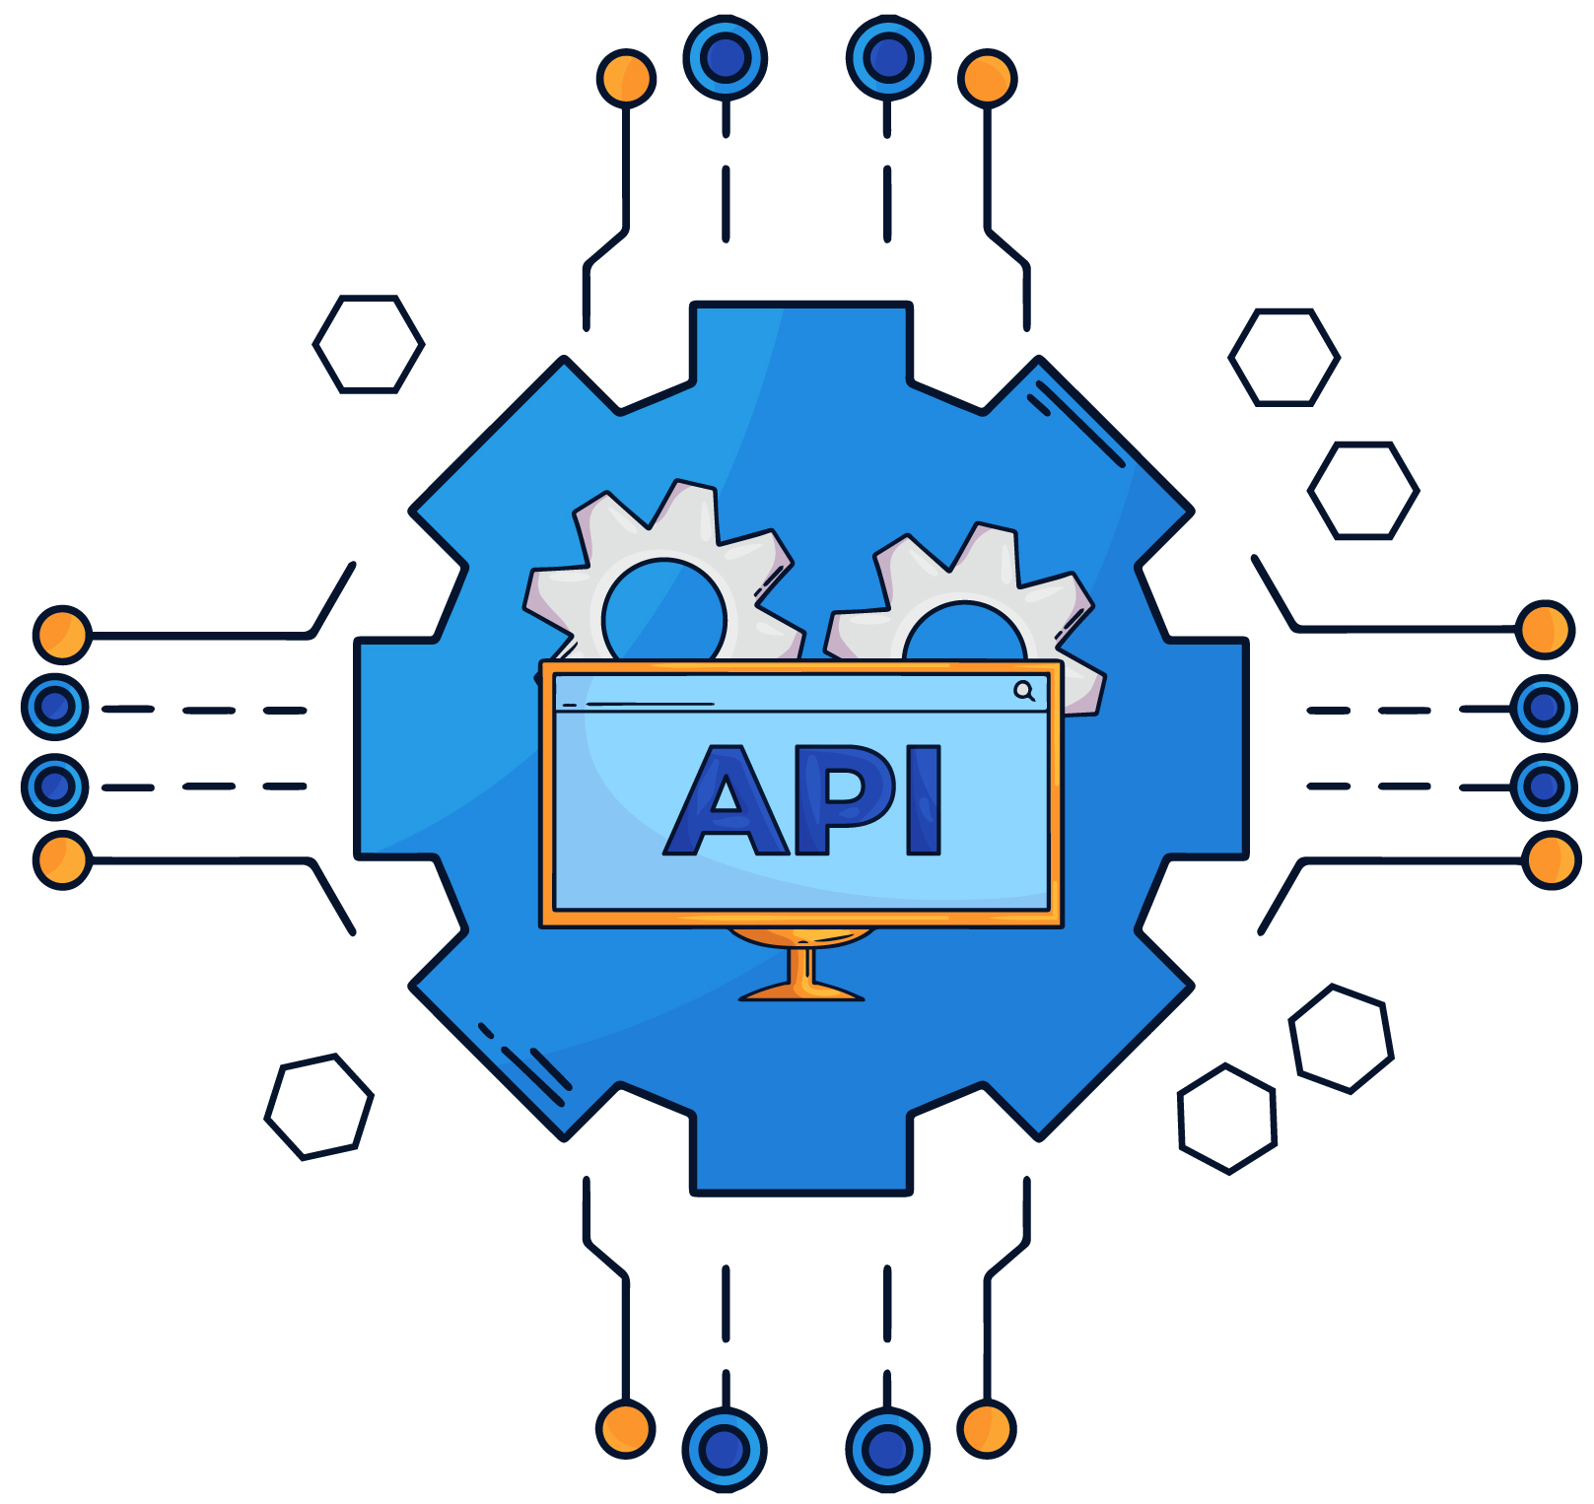
REST API Basics

Slide 2
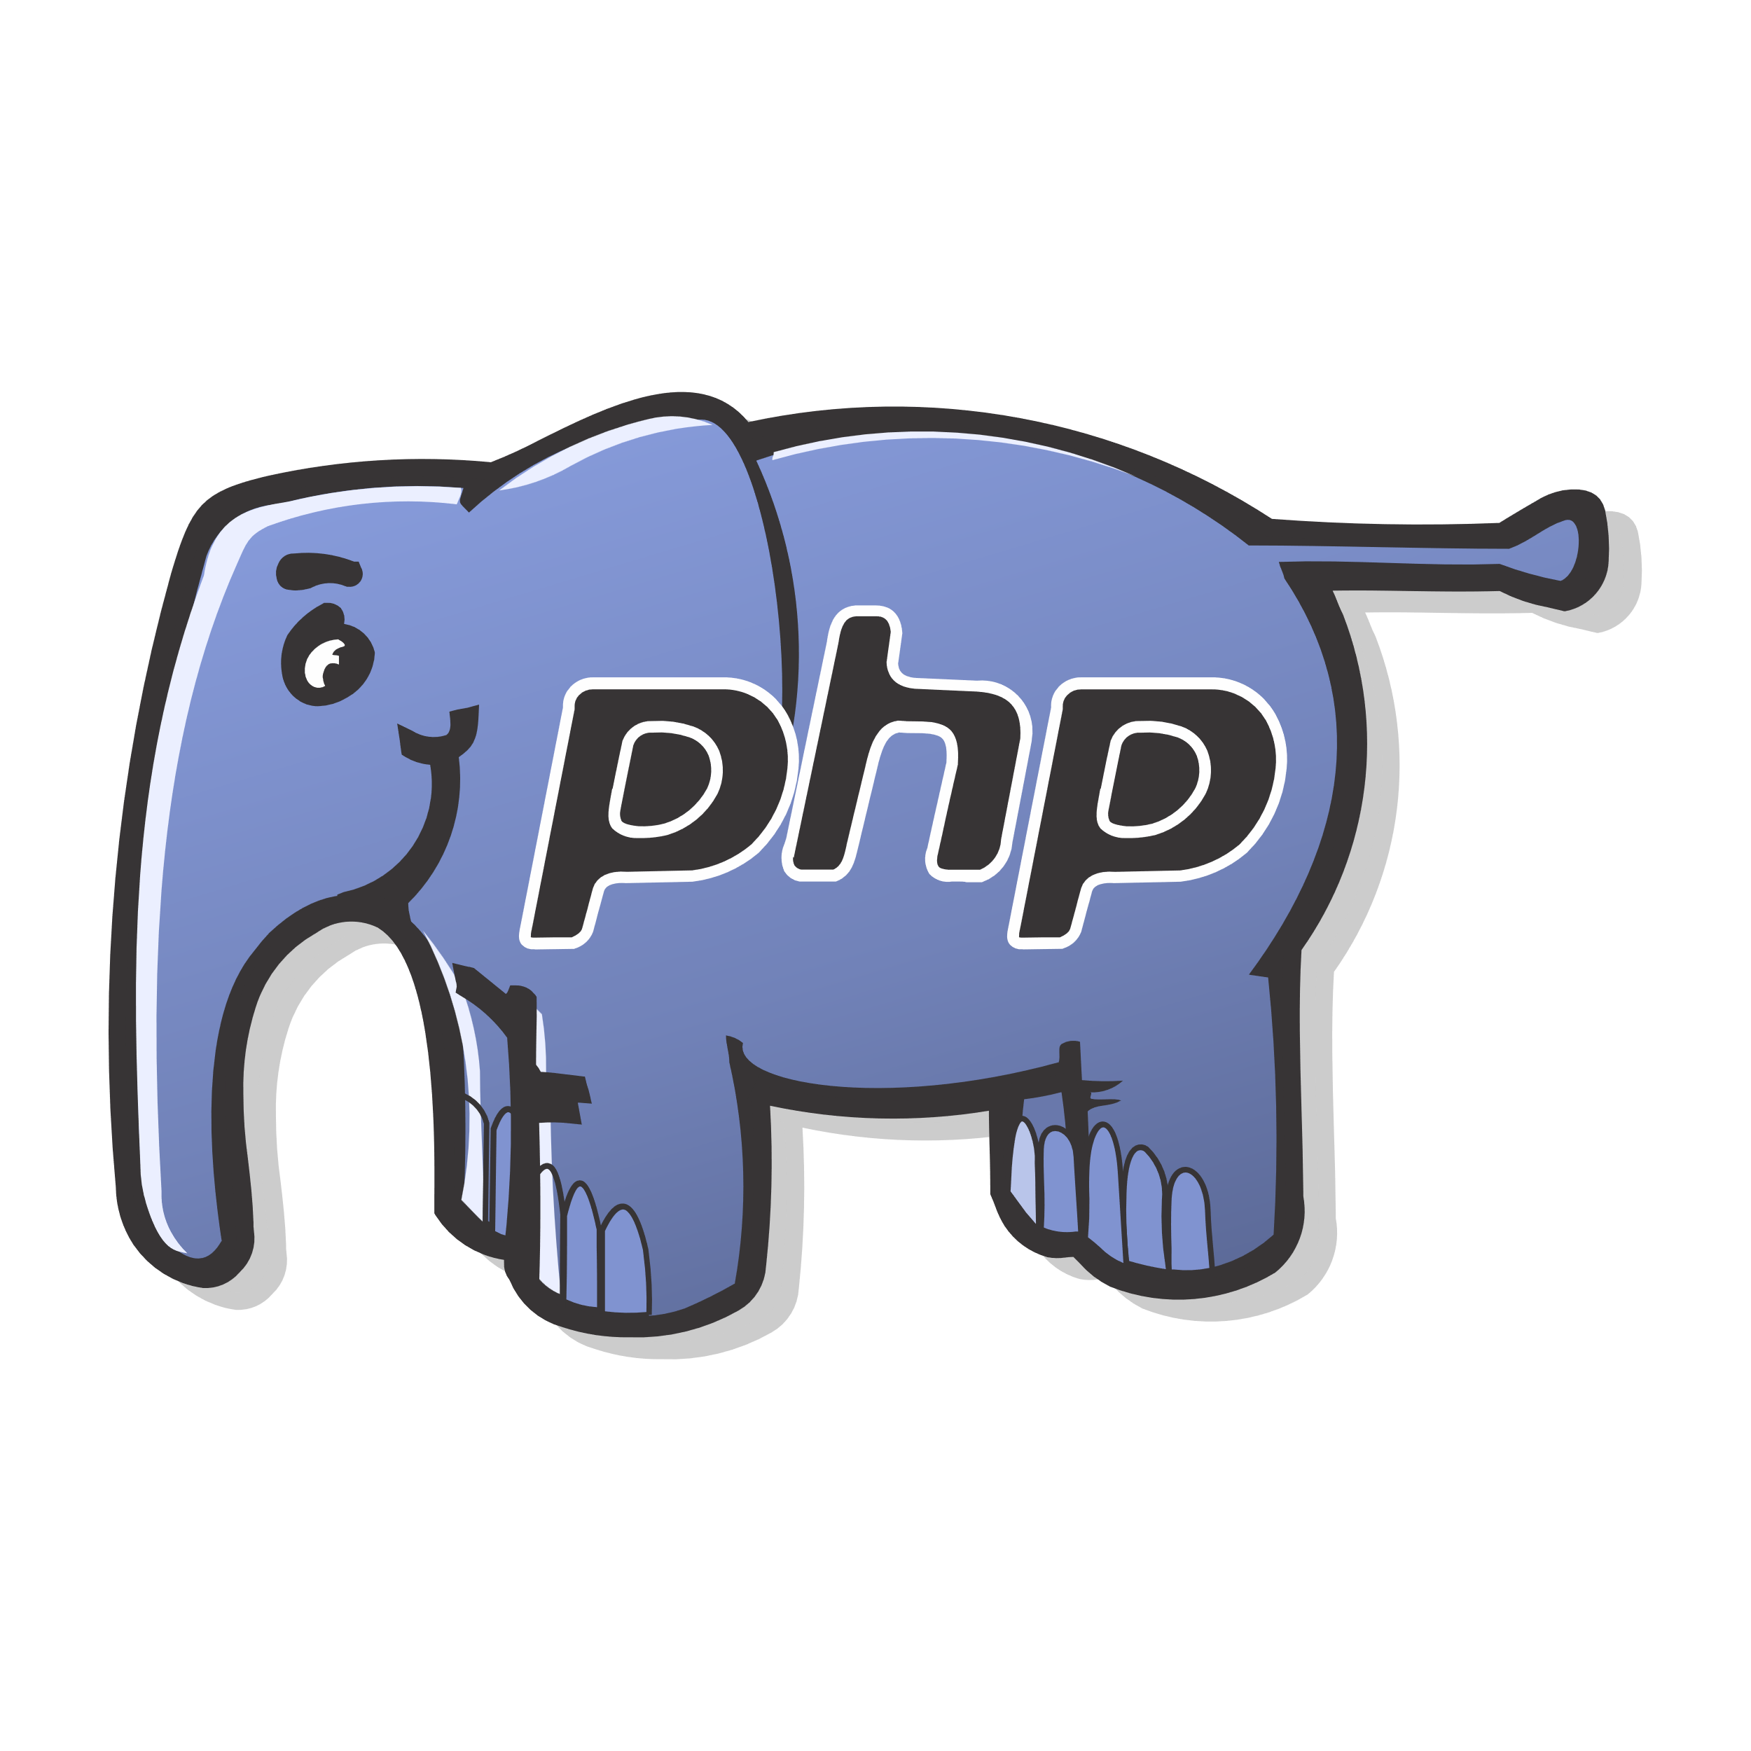
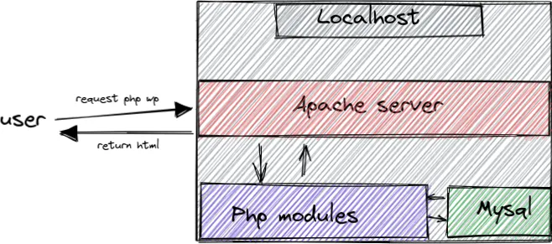
Day 10: PHP

Slide 3
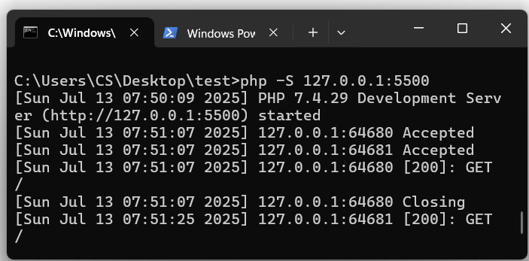
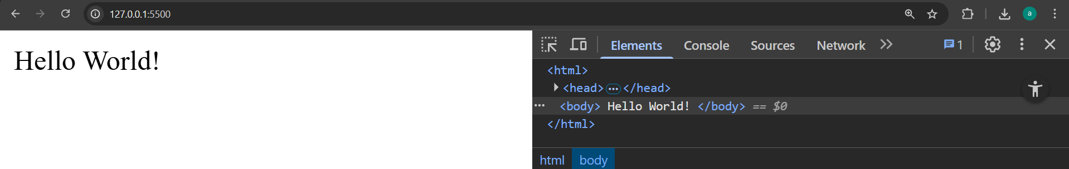
Day 10: How Client Can open PHP File
Client Browser
1
4
3
PHP module
Apache
2

Slide 4
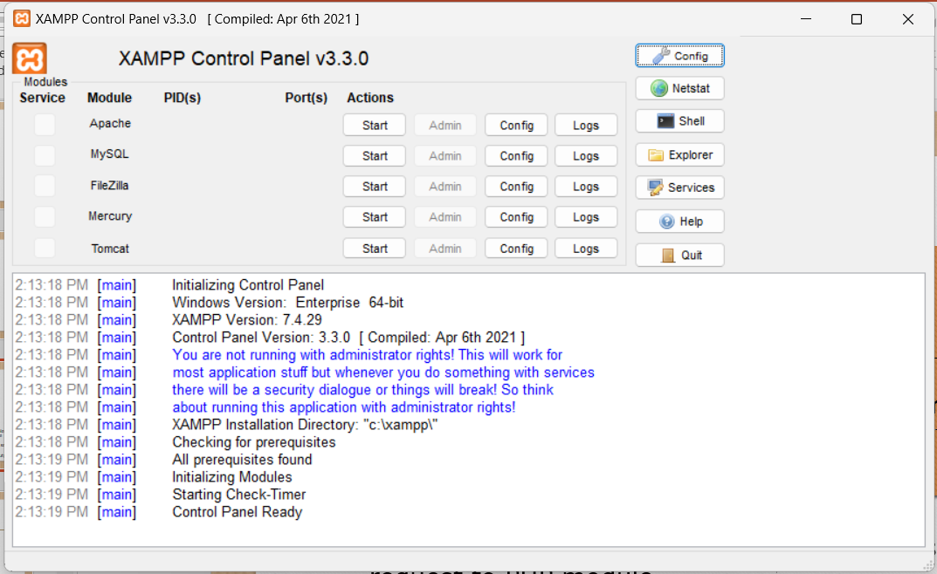
Day 10: Local Development Environment
Run Apache Server to start PHP codes and run MySQL server to start the database

Slide 5
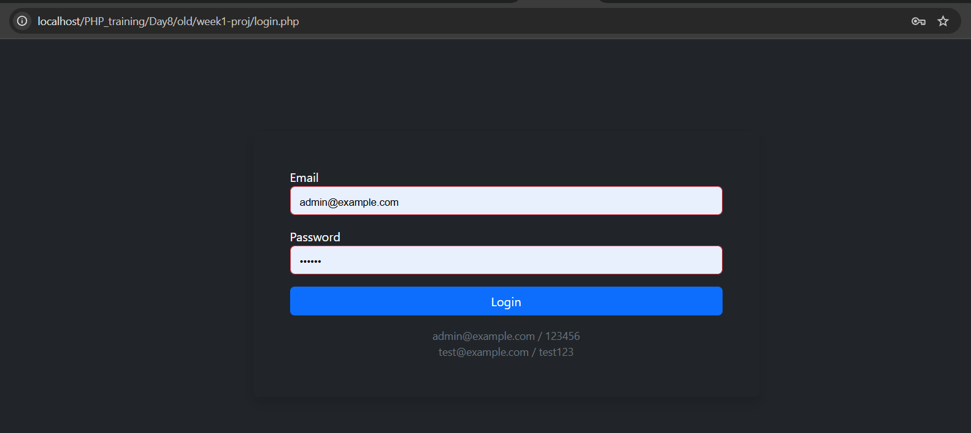
Day 10: Structure of a CRUD Page
Simple Login
Notes:
Syntax is crucial in programming for several reasons:
Clarity and Readability: Syntax provides a structured way to write code, making it easier for programmers to read and understand. Consistent syntax helps convey the intended logic and flow of the program.
Error Reduction: Strict syntax rules help catch errors early in the development process. If the syntax is incorrect, the compiler or interpreter will typically provide feedback, preventing the program from running until the issues are resolved.
Language Definition: Each programming language has its own syntax that defines how code is structured. This syntax is part of what distinguishes one language from another and defines how programmers interact with the language's features.
Tooling and Support: Many development tools, such as IDEs and linters, rely on the syntax of a programming language to provide features like code completion, syntax highlighting, and error detection. Changing the syntax could disrupt these tools' effectiveness.

Slide 6
Day 10: Structure of a CRUD Page
🔑 Hashing Passwords
❓ Example 1 – Hash password before saving in DB
$hashed = password_hash($_POST['password'], PASSWORD_DEFAULT);
💬لما نستخدمpassword_hash بنحمي الباسورد من السرقة حتى لو حد اخترق قاعدة البيانات، لأنه مش هيعرف يرجع الباسورد الأصلي.
❓ Example 2 – Verify password during login
if (password_verify($_POST['password'], $user['password'])) {
$_SESSION['user'] = $user['name'];
}
Notes:
Syntax is crucial in programming for several reasons:
Clarity and Readability: Syntax provides a structured way to write code, making it easier for programmers to read and understand. Consistent syntax helps convey the intended logic and flow of the program.
Error Reduction: Strict syntax rules help catch errors early in the development process. If the syntax is incorrect, the compiler or interpreter will typically provide feedback, preventing the program from running until the issues are resolved.
Language Definition: Each programming language has its own syntax that defines how code is structured. This syntax is part of what distinguishes one language from another and defines how programmers interact with the language's features.
Tooling and Support: Many development tools, such as IDEs and linters, rely on the syntax of a programming language to provide features like code completion, syntax highlighting, and error detection. Changing the syntax could disrupt these tools' effectiveness.

Slide 7
Day 10: Structure of a CRUD Page
📚 Extra: Hash vs Encryption
Feature | Hashing | Encryption
Purpose | Secure, one-way storage | Two-way data protection
Reversible | ❌ No | ✅ Yes
Common in | Passwords | Messages, files
PHP Example | md5(), password_hash() | openssl_encrypt()
💬الفرق الرئيسي إن الهاش بيتعمل مرة واحدة ومينفعش ترجع الأصل تاني، وده مناسب للباسورد. التشفير ينفع تفكه، زي لما تشفر ملف.
$myPass = "123456";
echo md5($myPass); // Not secure for production
❓ Create your own hash format
$custom = md5("customSalt" . $_POST['password’]);
💬 شرح للمدرب: يفضل عدم استخدام md5 لأنه قديم، بس بنستخدمه هنا كمثال توضيحي. ممكن تضيفsalt يدوي لزيادة الأمان.
Notes:
Syntax is crucial in programming for several reasons:
Clarity and Readability: Syntax provides a structured way to write code, making it easier for programmers to read and understand. Consistent syntax helps convey the intended logic and flow of the program.
Error Reduction: Strict syntax rules help catch errors early in the development process. If the syntax is incorrect, the compiler or interpreter will typically provide feedback, preventing the program from running until the issues are resolved.
Language Definition: Each programming language has its own syntax that defines how code is structured. This syntax is part of what distinguishes one language from another and defines how programmers interact with the language's features.
Tooling and Support: Many development tools, such as IDEs and linters, rely on the syntax of a programming language to provide features like code completion, syntax highlighting, and error detection. Changing the syntax could disrupt these tools' effectiveness.

Slide 8
Day 10: Structure of a CRUD Page
👤 User Roles (admin/user)
❓ Example 1 – Add a role column in users table
ALTER TABLE users ADD role VARCHAR(20) DEFAULT 'user’;
بنضيف عمود الدور في جدول المستخدمين علشان نميز بين المشرف والمستخدم العادي، وده هيساعدنا نخصص الصلاحيات.
if ($_SESSION['role'] == 'admin') {
// Show admin features
} else {
// Show user view only
}
Notes:
Syntax is crucial in programming for several reasons:
Clarity and Readability: Syntax provides a structured way to write code, making it easier for programmers to read and understand. Consistent syntax helps convey the intended logic and flow of the program.
Error Reduction: Strict syntax rules help catch errors early in the development process. If the syntax is incorrect, the compiler or interpreter will typically provide feedback, preventing the program from running until the issues are resolved.
Language Definition: Each programming language has its own syntax that defines how code is structured. This syntax is part of what distinguishes one language from another and defines how programmers interact with the language's features.
Tooling and Support: Many development tools, such as IDEs and linters, rely on the syntax of a programming language to provide features like code completion, syntax highlighting, and error detection. Changing the syntax could disrupt these tools' effectiveness.

Slide 9
Day 10: Structure of a CRUD Page
CRUD Security Tips
استخدم validation و sanitization على كل مدخلات المستخدم
دايمًا افحص البيانات قبل إدخالها في قاعدة البيانات
استخدم mysqli_real_escape_string() أو prepared statements
تأكد من وجود تأكيد قبل الحذف Confirm box))
لا تعتمد فقط على ID منURL بدون تحقق أو صلاحيات
مثال
mysqli_prepare($conn, "INSERT INTO login_logs (user_email, ip_address) VALUES (?, ?)");
mysqli_stmt_bind_param($logStmt, "ss", $email, $ip);
mysqli_stmt_execute($logStmt);
Notes:
Syntax is crucial in programming for several reasons:
Clarity and Readability: Syntax provides a structured way to write code, making it easier for programmers to read and understand. Consistent syntax helps convey the intended logic and flow of the program.
Error Reduction: Strict syntax rules help catch errors early in the development process. If the syntax is incorrect, the compiler or interpreter will typically provide feedback, preventing the program from running until the issues are resolved.
Language Definition: Each programming language has its own syntax that defines how code is structured. This syntax is part of what distinguishes one language from another and defines how programmers interact with the language's features.
Tooling and Support: Many development tools, such as IDEs and linters, rely on the syntax of a programming language to provide features like code completion, syntax highlighting, and error detection. Changing the syntax could disrupt these tools' effectiveness.

Slide 10
Day 10: 🛡️SQL Injection – Beginner Explanation + Examples
SQL Injection occurs when attackers insert malicious SQL into your query via input fields.
❓ Example of Vulnerable Code:
$email = $_POST['email'];
$password = $_POST['password'];
$sql = "SELECT * FROM users WHERE email='$email' AND password='$password’";
💬 لو المستخدم كتب ' OR 1=1 -- هيقدر يدخل من غير ما يعرف الباسورد! دا اسمه هجوم SQL Injection، وده خطر جدًا على قاعدة البيانات.
✅ Secure Version – Use Prepared Statements
$stmt = mysqli_prepare($con, "INSERT INTO Test values(?, ? )");
mysqli_stmt_bind_param($stmt, "si", $Name, $Age);
//Executing the statement
mysqli_stmt_execute($stmt);
💬prepare() بتفصل الكود عن البيانات، يعني حتى لو المستخدم دخل جملة SQL خبيثة، هتتعامل كأنها نص عادي مش كود.
Notes:
Syntax is crucial in programming for several reasons:
Clarity and Readability: Syntax provides a structured way to write code, making it easier for programmers to read and understand. Consistent syntax helps convey the intended logic and flow of the program.
Error Reduction: Strict syntax rules help catch errors early in the development process. If the syntax is incorrect, the compiler or interpreter will typically provide feedback, preventing the program from running until the issues are resolved.
Language Definition: Each programming language has its own syntax that defines how code is structured. This syntax is part of what distinguishes one language from another and defines how programmers interact with the language's features.
Tooling and Support: Many development tools, such as IDEs and linters, rely on the syntax of a programming language to provide features like code completion, syntax highlighting, and error detection. Changing the syntax could disrupt these tools' effectiveness.

Slide 11
Day 10: Structure of a CRUD Page
Frontend Best Practices (with Bootstrap)
استخدامBootstrap cards/tables لتنظيم البيانات
تنسيق المدخلات داخلforms بطريقة واضحة
تقديم ملاحظات للمستخدم Success / Error alerts))
استخدام Navbar لتسهيل التنقل بين الأقسام
الحفاظ على تصميم متناسق ومتجاوب مع الأجهزة
Notes:
Syntax is crucial in programming for several reasons:
Clarity and Readability: Syntax provides a structured way to write code, making it easier for programmers to read and understand. Consistent syntax helps convey the intended logic and flow of the program.
Error Reduction: Strict syntax rules help catch errors early in the development process. If the syntax is incorrect, the compiler or interpreter will typically provide feedback, preventing the program from running until the issues are resolved.
Language Definition: Each programming language has its own syntax that defines how code is structured. This syntax is part of what distinguishes one language from another and defines how programmers interact with the language's features.
Tooling and Support: Many development tools, such as IDEs and linters, rely on the syntax of a programming language to provide features like code completion, syntax highlighting, and error detection. Changing the syntax could disrupt these tools' effectiveness.

Slide 12
Day 10: First CRUD Project With DB
🧠student dashboard Task
📁 Project Structure
training_system
│ admin.php
│ dash.php
│ failed_logs.php
│ index.php
│ join.sql
│ login.php
│ logout.php
│ logs.php
│ navbar.php
│ register.php
│ user.php
📁 Project Structure
├───logs
│ failed_login.log
│ login.log
│
└───students
add_student.php
delete_student.php
edit_student.php
insert_student.php
students.php
update_student.php
Notes:
Syntax is crucial in programming for several reasons:
Clarity and Readability: Syntax provides a structured way to write code, making it easier for programmers to read and understand. Consistent syntax helps convey the intended logic and flow of the program.
Error Reduction: Strict syntax rules help catch errors early in the development process. If the syntax is incorrect, the compiler or interpreter will typically provide feedback, preventing the program from running until the issues are resolved.
Language Definition: Each programming language has its own syntax that defines how code is structured. This syntax is part of what distinguishes one language from another and defines how programmers interact with the language's features.
Tooling and Support: Many development tools, such as IDEs and linters, rely on the syntax of a programming language to provide features like code completion, syntax highlighting, and error detection. Changing the syntax could disrupt these tools' effectiveness.

Slide 13
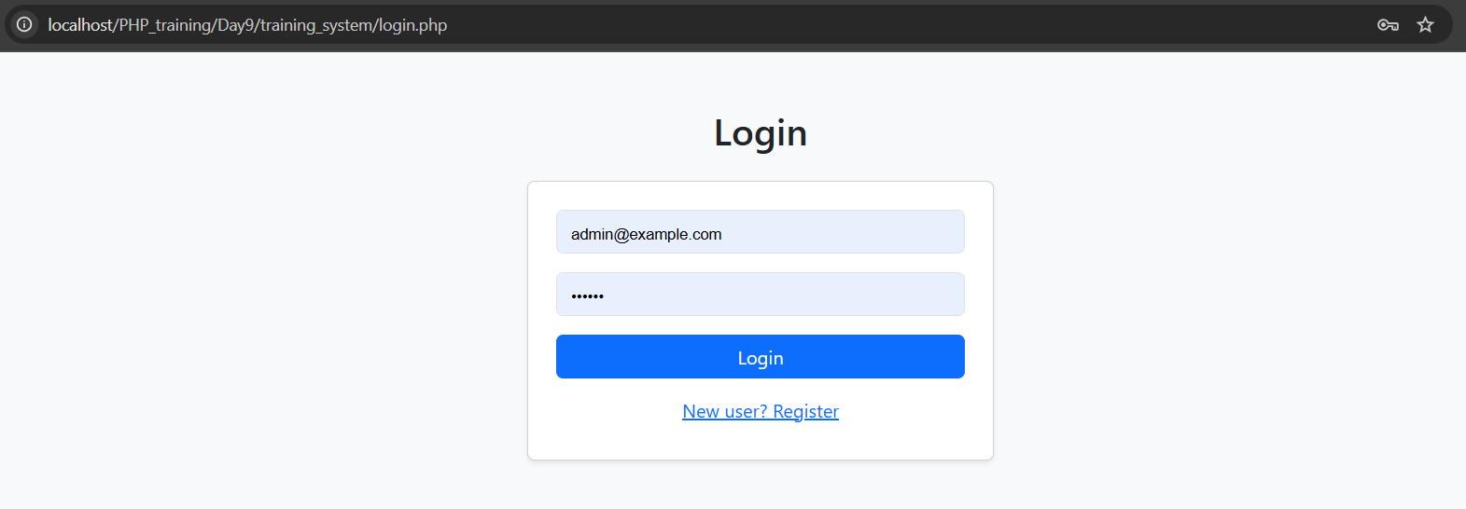
Day 10: Structure of a CRUD Page
Simple Login
Notes:
Syntax is crucial in programming for several reasons:
Clarity and Readability: Syntax provides a structured way to write code, making it easier for programmers to read and understand. Consistent syntax helps convey the intended logic and flow of the program.
Error Reduction: Strict syntax rules help catch errors early in the development process. If the syntax is incorrect, the compiler or interpreter will typically provide feedback, preventing the program from running until the issues are resolved.
Language Definition: Each programming language has its own syntax that defines how code is structured. This syntax is part of what distinguishes one language from another and defines how programmers interact with the language's features.
Tooling and Support: Many development tools, such as IDEs and linters, rely on the syntax of a programming language to provide features like code completion, syntax highlighting, and error detection. Changing the syntax could disrupt these tools' effectiveness.

Slide 14
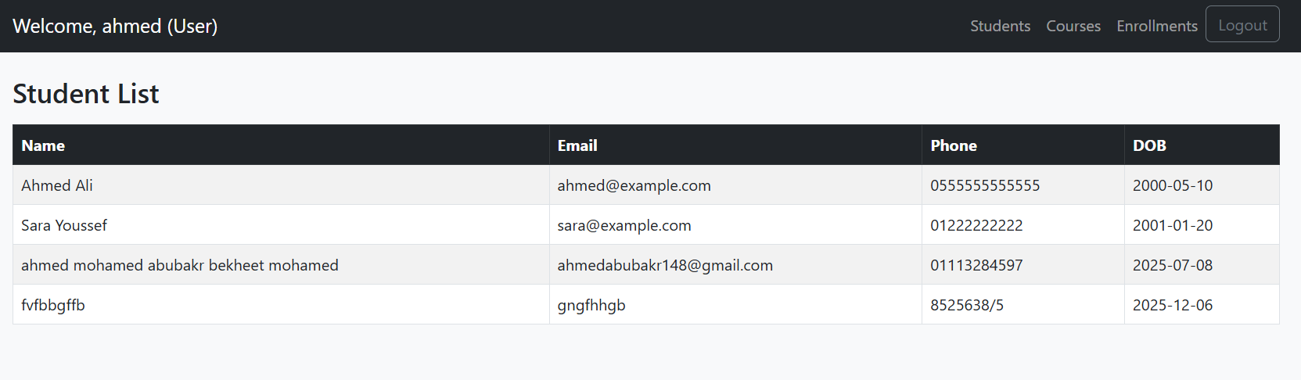
Day 10: Structure of a CRUD Page
Live Task – Students CRUD
Notes:
Syntax is crucial in programming for several reasons:
Clarity and Readability: Syntax provides a structured way to write code, making it easier for programmers to read and understand. Consistent syntax helps convey the intended logic and flow of the program.
Error Reduction: Strict syntax rules help catch errors early in the development process. If the syntax is incorrect, the compiler or interpreter will typically provide feedback, preventing the program from running until the issues are resolved.
Language Definition: Each programming language has its own syntax that defines how code is structured. This syntax is part of what distinguishes one language from another and defines how programmers interact with the language's features.
Tooling and Support: Many development tools, such as IDEs and linters, rely on the syntax of a programming language to provide features like code completion, syntax highlighting, and error detection. Changing the syntax could disrupt these tools' effectiveness.

Slide 15
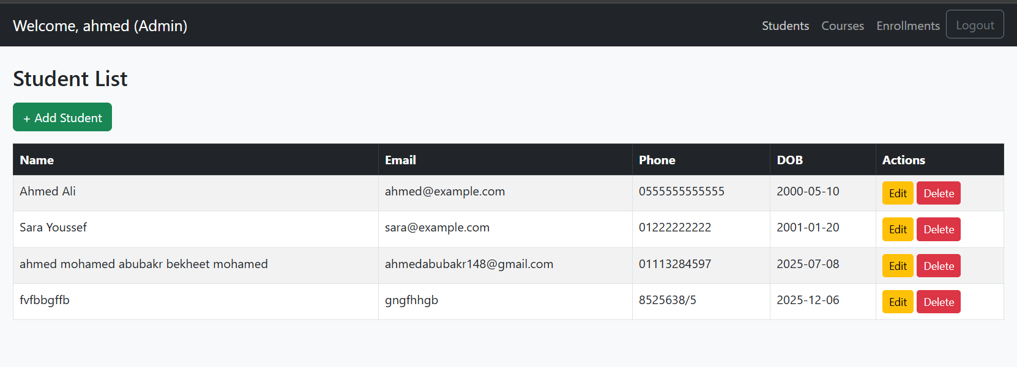
Day 10: Structure of a CRUD Page
Live Task – Students CRUD
Notes:
Syntax is crucial in programming for several reasons:
Clarity and Readability: Syntax provides a structured way to write code, making it easier for programmers to read and understand. Consistent syntax helps convey the intended logic and flow of the program.
Error Reduction: Strict syntax rules help catch errors early in the development process. If the syntax is incorrect, the compiler or interpreter will typically provide feedback, preventing the program from running until the issues are resolved.
Language Definition: Each programming language has its own syntax that defines how code is structured. This syntax is part of what distinguishes one language from another and defines how programmers interact with the language's features.
Tooling and Support: Many development tools, such as IDEs and linters, rely on the syntax of a programming language to provide features like code completion, syntax highlighting, and error detection. Changing the syntax could disrupt these tools' effectiveness.

Slide 16
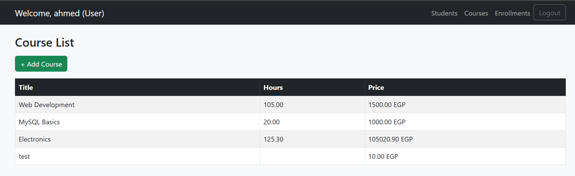
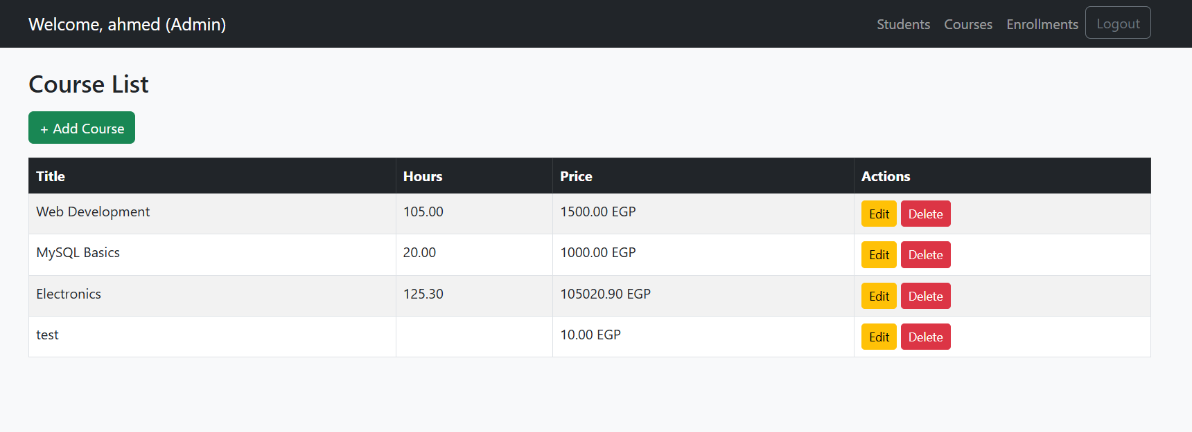
Day 10: Structure of a CRUD Page
Task – Courses CRUD
Notes:
Syntax is crucial in programming for several reasons:
Clarity and Readability: Syntax provides a structured way to write code, making it easier for programmers to read and understand. Consistent syntax helps convey the intended logic and flow of the program.
Error Reduction: Strict syntax rules help catch errors early in the development process. If the syntax is incorrect, the compiler or interpreter will typically provide feedback, preventing the program from running until the issues are resolved.
Language Definition: Each programming language has its own syntax that defines how code is structured. This syntax is part of what distinguishes one language from another and defines how programmers interact with the language's features.
Tooling and Support: Many development tools, such as IDEs and linters, rely on the syntax of a programming language to provide features like code completion, syntax highlighting, and error detection. Changing the syntax could disrupt these tools' effectiveness.

Slide 17
Day 10: JOINs
🔗 ما هو الـ JOIN؟
هو طريقة لجلب البيانات من جدولين أو أكثر بناءً على علاقة (عادةً باستخدام مفتاح خارجي FOREIGN KEY).
نوع الـ JOIN | يعرض من الجدول الأول؟ | يعرض من الجدول الثاني؟ | فقط لو في علاقة؟
INNER JOIN (JOIN) | ✅ نعم | ✅ نعم | ✅ نعم
LEFT JOIN | ✅ نعم | ✅ نعم / NULL | ❌
RIGHT JOIN | ✅ نعم / NULL | ✅ نعم | ❌
FULL OUTER JOIN | ✅ نعم / NULL | ✅ نعم / NULL | ❌
Notes:
Syntax is crucial in programming for several reasons:
Clarity and Readability: Syntax provides a structured way to write code, making it easier for programmers to read and understand. Consistent syntax helps convey the intended logic and flow of the program.
Error Reduction: Strict syntax rules help catch errors early in the development process. If the syntax is incorrect, the compiler or interpreter will typically provide feedback, preventing the program from running until the issues are resolved.
Language Definition: Each programming language has its own syntax that defines how code is structured. This syntax is part of what distinguishes one language from another and defines how programmers interact with the language's features.
Tooling and Support: Many development tools, such as IDEs and linters, rely on the syntax of a programming language to provide features like code completion, syntax highlighting, and error detection. Changing the syntax could disrupt these tools' effectiveness.

Slide 18
Day 10: JOINs
✅ مثال عملي سريع:
id | name
1 | Ahmed
2 | Mariam
3 | Samir
id | student_id | course
1 | 1 | Math
2 | 1 | Physics
3 | 2 | Chemistry
⬅ INNER JOIN يعرض أحمد ومريم فقط
LEFT JOIN ⬅يعرض أحمد، مريم، سامر (سامر ليس لديه كورسات = NULL)
RIGHT JOIN ⬅يعرض أحمد، مريم فقط، لأن كل الكورسات تخصهم فقط
FULL OUTER JOIN ⬅يعرض الكل حتى لو مفيش تطابق
Notes:
Syntax is crucial in programming for several reasons:
Clarity and Readability: Syntax provides a structured way to write code, making it easier for programmers to read and understand. Consistent syntax helps convey the intended logic and flow of the program.
Error Reduction: Strict syntax rules help catch errors early in the development process. If the syntax is incorrect, the compiler or interpreter will typically provide feedback, preventing the program from running until the issues are resolved.
Language Definition: Each programming language has its own syntax that defines how code is structured. This syntax is part of what distinguishes one language from another and defines how programmers interact with the language's features.
Tooling and Support: Many development tools, such as IDEs and linters, rely on the syntax of a programming language to provide features like code completion, syntax highlighting, and error detection. Changing the syntax could disrupt these tools' effectiveness.

Slide 19
Day 10: Structure of a CRUD Page
Task – Enrollments CRUD
إنشاء CRUD لإدارة التسجيلات enrollments المطلوب:
ربط طالب بكورس
تخزين grade
عرض قائمة تحتوي:
اسم الطالب
عنوان الكورس
التقدير
التاريخ
استخدم العلاقات JOIN بين الجداول
استخدم Select dropdowns لاختيار الطالب والكورس
Notes:
Syntax is crucial in programming for several reasons:
Clarity and Readability: Syntax provides a structured way to write code, making it easier for programmers to read and understand. Consistent syntax helps convey the intended logic and flow of the program.
Error Reduction: Strict syntax rules help catch errors early in the development process. If the syntax is incorrect, the compiler or interpreter will typically provide feedback, preventing the program from running until the issues are resolved.
Language Definition: Each programming language has its own syntax that defines how code is structured. This syntax is part of what distinguishes one language from another and defines how programmers interact with the language's features.
Tooling and Support: Many development tools, such as IDEs and linters, rely on the syntax of a programming language to provide features like code completion, syntax highlighting, and error detection. Changing the syntax could disrupt these tools' effectiveness.

Slide 20
Day 10: Task project
🧩 Final Project – Secure Login Panel
Requirements:
Register form (Bootstrap)
Login form + session
Password hashing
User roles with different dashboard UI
Logout link
Protect all pages with session checks
Optional Bonus:
Log IP and login time
Store login logs in database or text file
Notes:
Syntax is crucial in programming for several reasons:
Clarity and Readability: Syntax provides a structured way to write code, making it easier for programmers to read and understand. Consistent syntax helps convey the intended logic and flow of the program.
Error Reduction: Strict syntax rules help catch errors early in the development process. If the syntax is incorrect, the compiler or interpreter will typically provide feedback, preventing the program from running until the issues are resolved.
Language Definition: Each programming language has its own syntax that defines how code is structured. This syntax is part of what distinguishes one language from another and defines how programmers interact with the language's features.
Tooling and Support: Many development tools, such as IDEs and linters, rely on the syntax of a programming language to provide features like code completion, syntax highlighting, and error detection. Changing the syntax could disrupt these tools' effectiveness.

Slide 21
Day 10: Intro to API
Database JOIN Recap
JOIN بيربط بيانات من جداول متعددة
مثال: نعرض أسماء الطلاب، الكورسات، والدرجات من جدول enrollments
SELECT students.name, courses.title, enrollments.grade
FROM enrollments
JOIN students ON enrollments.student_id = students.id
JOIN courses ON enrollments.course_id = courses.id
Notes:
Syntax is crucial in programming for several reasons:
Clarity and Readability: Syntax provides a structured way to write code, making it easier for programmers to read and understand. Consistent syntax helps convey the intended logic and flow of the program.
Error Reduction: Strict syntax rules help catch errors early in the development process. If the syntax is incorrect, the compiler or interpreter will typically provide feedback, preventing the program from running until the issues are resolved.
Language Definition: Each programming language has its own syntax that defines how code is structured. This syntax is part of what distinguishes one language from another and defines how programmers interact with the language's features.
Tooling and Support: Many development tools, such as IDEs and linters, rely on the syntax of a programming language to provide features like code completion, syntax highlighting, and error detection. Changing the syntax could disrupt these tools' effectiveness.

Slide 22
Day 10: Intro to API
Database JOIN Recap
JOIN بيربط بيانات من جداول متعددة
مثال: نعرض أسماء الطلاب، الكورسات، والدرجات من جدول enrollments
SELECT students.name, courses.title, enrollments.grade
FROM enrollments
JOIN students ON enrollments.student_id = students.id
JOIN courses ON enrollments.course_id = courses.id
Task
أنشئ View باسم view_student_courses باستخدام الاستعلام السابق.
Notes:
Syntax is crucial in programming for several reasons:
Clarity and Readability: Syntax provides a structured way to write code, making it easier for programmers to read and understand. Consistent syntax helps convey the intended logic and flow of the program.
Error Reduction: Strict syntax rules help catch errors early in the development process. If the syntax is incorrect, the compiler or interpreter will typically provide feedback, preventing the program from running until the issues are resolved.
Language Definition: Each programming language has its own syntax that defines how code is structured. This syntax is part of what distinguishes one language from another and defines how programmers interact with the language's features.
Tooling and Support: Many development tools, such as IDEs and linters, rely on the syntax of a programming language to provide features like code completion, syntax highlighting, and error detection. Changing the syntax could disrupt these tools' effectiveness.

Slide 23
Day 10: Intro to API
API = Application Programming Interface
وسيلة لتواصل الأنظمة
REST = Representational State Transfer
نوع من أنواع الـ API بيستخدم HTTP
بيستخدم الطرق: GET, POST, PUT, DELETE
بيرجع البيانات بصيغة JSON
Notes:
Syntax is crucial in programming for several reasons:
Clarity and Readability: Syntax provides a structured way to write code, making it easier for programmers to read and understand. Consistent syntax helps convey the intended logic and flow of the program.
Error Reduction: Strict syntax rules help catch errors early in the development process. If the syntax is incorrect, the compiler or interpreter will typically provide feedback, preventing the program from running until the issues are resolved.
Language Definition: Each programming language has its own syntax that defines how code is structured. This syntax is part of what distinguishes one language from another and defines how programmers interact with the language's features.
Tooling and Support: Many development tools, such as IDEs and linters, rely on the syntax of a programming language to provide features like code completion, syntax highlighting, and error detection. Changing the syntax could disrupt these tools' effectiveness.

Slide 24
Day 10: Intro to API
REST Methods Overview
Method | Description | DB Equivalent
GET | جلب بيانات | SELECT
POST | إضافة بيانات | INSERT
PUT | تعديل بيانات | UPDATE
DELETE | حذف بيانات | DELETE
Task
أي طريقة تستخدم لتحديث إيميل طالب؟
Notes:
Syntax is crucial in programming for several reasons:
Clarity and Readability: Syntax provides a structured way to write code, making it easier for programmers to read and understand. Consistent syntax helps convey the intended logic and flow of the program.
Error Reduction: Strict syntax rules help catch errors early in the development process. If the syntax is incorrect, the compiler or interpreter will typically provide feedback, preventing the program from running until the issues are resolved.
Language Definition: Each programming language has its own syntax that defines how code is structured. This syntax is part of what distinguishes one language from another and defines how programmers interact with the language's features.
Tooling and Support: Many development tools, such as IDEs and linters, rely on the syntax of a programming language to provide features like code completion, syntax highlighting, and error detection. Changing the syntax could disrupt these tools' effectiveness.

Slide 25
Day 10: Intro to API
REST Methods Overview
Method | Description | DB Equivalent
GET | جلب بيانات | SELECT
POST | إضافة بيانات | INSERT
PUT | تعديل بيانات | UPDATE
DELETE | حذف بيانات | DELETE
GET Example (courses)
GET /api/courses.php // جلب كل الكورسات
GET /api/courses.php?id=2 // جلب كورس محدد
Data will be in JSON formt so what is JSON
Notes:
Syntax is crucial in programming for several reasons:
Clarity and Readability: Syntax provides a structured way to write code, making it easier for programmers to read and understand. Consistent syntax helps convey the intended logic and flow of the program.
Error Reduction: Strict syntax rules help catch errors early in the development process. If the syntax is incorrect, the compiler or interpreter will typically provide feedback, preventing the program from running until the issues are resolved.
Language Definition: Each programming language has its own syntax that defines how code is structured. This syntax is part of what distinguishes one language from another and defines how programmers interact with the language's features.
Tooling and Support: Many development tools, such as IDEs and linters, rely on the syntax of a programming language to provide features like code completion, syntax highlighting, and error detection. Changing the syntax could disrupt these tools' effectiveness.

Slide 26
Day 10: Intro to API
REST Methods Overview
fetch('/api/courses.php', {
method: 'POST',
body: JSON.stringify({ title: "PHP", price: 200 }),
headers: { "Content-Type": "application/json" }
});
$data = json_decode(file_get_contents("php://input"), true);
$title = $data['title'];
$price = $data['price’];
mysqli_query($conn, "INSERT INTO courses (title, price) VALUES ('$title', '$price')");
Notes:
Syntax is crucial in programming for several reasons:
Clarity and Readability: Syntax provides a structured way to write code, making it easier for programmers to read and understand. Consistent syntax helps convey the intended logic and flow of the program.
Error Reduction: Strict syntax rules help catch errors early in the development process. If the syntax is incorrect, the compiler or interpreter will typically provide feedback, preventing the program from running until the issues are resolved.
Language Definition: Each programming language has its own syntax that defines how code is structured. This syntax is part of what distinguishes one language from another and defines how programmers interact with the language's features.
Tooling and Support: Many development tools, such as IDEs and linters, rely on the syntax of a programming language to provide features like code completion, syntax highlighting, and error detection. Changing the syntax could disrupt these tools' effectiveness.

Slide 27
Day 10: Intro to API
REST Methods Overview
fetch('/api/courses.php', {
method: 'PUT',
body: JSON.stringify({ id: 2, title: "Updated PHP" }),
headers: { "Content-Type": "application/json" }
});
parse_str(file_get_contents("php://input"), $data);
$id = $data['id'];
$title = $data['title’];
mysqli_query($conn, "UPDATE courses SET title='$title' WHERE id=$id");
Notes:
Syntax is crucial in programming for several reasons:
Clarity and Readability: Syntax provides a structured way to write code, making it easier for programmers to read and understand. Consistent syntax helps convey the intended logic and flow of the program.
Error Reduction: Strict syntax rules help catch errors early in the development process. If the syntax is incorrect, the compiler or interpreter will typically provide feedback, preventing the program from running until the issues are resolved.
Language Definition: Each programming language has its own syntax that defines how code is structured. This syntax is part of what distinguishes one language from another and defines how programmers interact with the language's features.
Tooling and Support: Many development tools, such as IDEs and linters, rely on the syntax of a programming language to provide features like code completion, syntax highlighting, and error detection. Changing the syntax could disrupt these tools' effectiveness.

Slide 28
Day 10: Intro to API
REST Methods Overview
fetch('/api/courses.php?id=2', {
method: 'DELETE’,
body: JSON.stringify({ id: 2 })
});
parse_str(file_get_contents("php://input"), $data);
$id = $data['id’];
mysqli_query($conn, "DELETE FROM courses WHERE id=$id");
Notes:
Syntax is crucial in programming for several reasons:
Clarity and Readability: Syntax provides a structured way to write code, making it easier for programmers to read and understand. Consistent syntax helps convey the intended logic and flow of the program.
Error Reduction: Strict syntax rules help catch errors early in the development process. If the syntax is incorrect, the compiler or interpreter will typically provide feedback, preventing the program from running until the issues are resolved.
Language Definition: Each programming language has its own syntax that defines how code is structured. This syntax is part of what distinguishes one language from another and defines how programmers interact with the language's features.
Tooling and Support: Many development tools, such as IDEs and linters, rely on the syntax of a programming language to provide features like code completion, syntax highlighting, and error detection. Changing the syntax could disrupt these tools' effectiveness.

Slide 29

Day 10: Intro to API
Security – Login with Token
المستخدم يسجل دخول عبر POST إلى /api/login.php
السيرفر يرجع Token⬅ سلسلة مشفرة تمثل المستخدم
المتصفح يخزن الـToken في localStorage او ال cookies
كل طلب API بيبعت التوكن في الهيدر Authorization (جزا متقدم وافضل)
السيرفر يتحقق من التوكن قبل تنفيذ أي عملية لحماية البيانات
خزّن اسم المستخدم فيlocalStorage واظهره في الـ navbar.
Notes:
Syntax is crucial in programming for several reasons:
Clarity and Readability: Syntax provides a structured way to write code, making it easier for programmers to read and understand. Consistent syntax helps convey the intended logic and flow of the program.
Error Reduction: Strict syntax rules help catch errors early in the development process. If the syntax is incorrect, the compiler or interpreter will typically provide feedback, preventing the program from running until the issues are resolved.
Language Definition: Each programming language has its own syntax that defines how code is structured. This syntax is part of what distinguishes one language from another and defines how programmers interact with the language's features.
Tooling and Support: Many development tools, such as IDEs and linters, rely on the syntax of a programming language to provide features like code completion, syntax highlighting, and error detection. Changing the syntax could disrupt these tools' effectiveness.

Slide 30
Day 10: Intro to API
🛡️ ما فائدة التوكن؟
يحافظ على هوية المستخدم بعد تسجيل الدخول
يمنع الوصول غير المصرح به للـ API
يمكن اعتباره بديل للجلسات لكنه أسهل في الواجهة الأمامية
خزّن اسم المستخدم فيlocalStorage واظهره في الـ navbar.
Notes:
Syntax is crucial in programming for several reasons:
Clarity and Readability: Syntax provides a structured way to write code, making it easier for programmers to read and understand. Consistent syntax helps convey the intended logic and flow of the program.
Error Reduction: Strict syntax rules help catch errors early in the development process. If the syntax is incorrect, the compiler or interpreter will typically provide feedback, preventing the program from running until the issues are resolved.
Language Definition: Each programming language has its own syntax that defines how code is structured. This syntax is part of what distinguishes one language from another and defines how programmers interact with the language's features.
Tooling and Support: Many development tools, such as IDEs and linters, rely on the syntax of a programming language to provide features like code completion, syntax highlighting, and error detection. Changing the syntax could disrupt these tools' effectiveness.

Slide 31
Day 10: Intro to API
🛡️ Authentication in UI
كل صفحة تتحقق من وجود التوكن:
<script>
if (!localStorage.getItem("token")) {
alert("🔒 Please login to access this page");
window.location.href = "login.html";
}
</script>
أضف حماية التوكن إلى students.html, courses.html, enrollments.html
Notes:
Syntax is crucial in programming for several reasons:
Clarity and Readability: Syntax provides a structured way to write code, making it easier for programmers to read and understand. Consistent syntax helps convey the intended logic and flow of the program.
Error Reduction: Strict syntax rules help catch errors early in the development process. If the syntax is incorrect, the compiler or interpreter will typically provide feedback, preventing the program from running until the issues are resolved.
Language Definition: Each programming language has its own syntax that defines how code is structured. This syntax is part of what distinguishes one language from another and defines how programmers interact with the language's features.
Tooling and Support: Many development tools, such as IDEs and linters, rely on the syntax of a programming language to provide features like code completion, syntax highlighting, and error detection. Changing the syntax could disrupt these tools' effectiveness.

Slide 32
Day 10: Intro to API
🛡️ Authentication in UI
كل صفحة تتحقق من وجود التوكن:
أو عند استخدام cookies:
<script>
function getCookie(name) {
let match = document.cookie.match(new RegExp('(^| )' + name + '=([^;]+)'));
return match ? decodeURIComponent(match[2]) : null;
}
</script>
if (!getCookie("token")) {
alert("❌ Access Denied. Please login first.");
window.location.href = "login.html";
}
عند إعداد الكوكي في PHP:
setcookie("token", $token, time() + 86400, "/"); // صالح ليوم كامل (86400 ثانية)
time() بيرجع عدد الثواني من 1 Jan 1970 (Epoch)
time() + 86400 = الوقت الحالي + يوم (24 × 60 × 60)
Notes:
Syntax is crucial in programming for several reasons:
Clarity and Readability: Syntax provides a structured way to write code, making it easier for programmers to read and understand. Consistent syntax helps convey the intended logic and flow of the program.
Error Reduction: Strict syntax rules help catch errors early in the development process. If the syntax is incorrect, the compiler or interpreter will typically provide feedback, preventing the program from running until the issues are resolved.
Language Definition: Each programming language has its own syntax that defines how code is structured. This syntax is part of what distinguishes one language from another and defines how programmers interact with the language's features.
Tooling and Support: Many development tools, such as IDEs and linters, rely on the syntax of a programming language to provide features like code completion, syntax highlighting, and error detection. Changing the syntax could disrupt these tools' effectiveness.

Slide 33
Day 10: Intro to API
🛡️ Authentication in UI
Cookies vs LocalStorage
Feature | Cookies | LocalStorage
الحجم الأقصى | حوالي 4KB | حوالي 5MB
تاريخ الانتهاء | له صلاحية زمنية | يبقى دائمًا حتى يتم حذفه يدويًا
بيترسل تلقائيًا؟ | نعم، مع كل طلب HTTP | لا، لازم تبعته يدويًا في JS
الأمان | ممكن يُسرق لو بدون HTTPS | أكثر أمانًا، لكنه مكشوف في المتصفح
الاستخدام الأفضل | إدارة الجلسات – التوثيق مع السيرفر | حفظ بيانات الواجهة – مثل التوكن
في مشروعك، خزّن التوكن في cookies لكن خزّن اسم المستخدم في. localStorage ثم استخدمهم معًا داخل navbar والترحيب.
Notes:
Syntax is crucial in programming for several reasons:
Clarity and Readability: Syntax provides a structured way to write code, making it easier for programmers to read and understand. Consistent syntax helps convey the intended logic and flow of the program.
Error Reduction: Strict syntax rules help catch errors early in the development process. If the syntax is incorrect, the compiler or interpreter will typically provide feedback, preventing the program from running until the issues are resolved.
Language Definition: Each programming language has its own syntax that defines how code is structured. This syntax is part of what distinguishes one language from another and defines how programmers interact with the language's features.
Tooling and Support: Many development tools, such as IDEs and linters, rely on the syntax of a programming language to provide features like code completion, syntax highlighting, and error detection. Changing the syntax could disrupt these tools' effectiveness.

Slide 34
Day 10: Task project
🧩 Final Project – Secure Login Panel
ابنِ CRUD كامل لجدول الطلاب باستخدام:
students_api/get.php
students_api/post.php
students_api/put.php
students_api/delete.php
🧩 استخدم Bootstrap + fetch() + token + navbar
Notes:
Syntax is crucial in programming for several reasons:
Clarity and Readability: Syntax provides a structured way to write code, making it easier for programmers to read and understand. Consistent syntax helps convey the intended logic and flow of the program.
Error Reduction: Strict syntax rules help catch errors early in the development process. If the syntax is incorrect, the compiler or interpreter will typically provide feedback, preventing the program from running until the issues are resolved.
Language Definition: Each programming language has its own syntax that defines how code is structured. This syntax is part of what distinguishes one language from another and defines how programmers interact with the language's features.
Tooling and Support: Many development tools, such as IDEs and linters, rely on the syntax of a programming language to provide features like code completion, syntax highlighting, and error detection. Changing the syntax could disrupt these tools' effectiveness.

Slide 35

The End Of Day 10
Feel free to contact me any time
linktr.ee/ahmed_abubakr

